Slide 1
Constraints
C393: Database Systems

Slide 2
Review

Slide 3
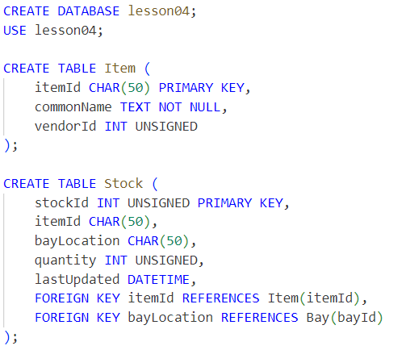
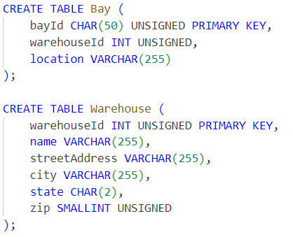
Success or Fail?
Notes:
CHAR(50) UNSIGNED is not valid in Bay table

Slide 4
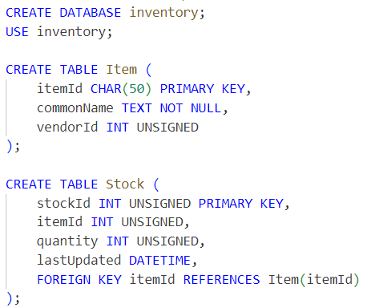
Another
Notes:
itemId in Stock references itemId in Item, datatype mismatch

Slide 5
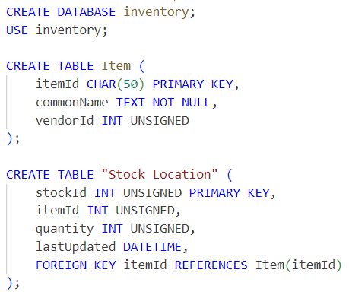
Another
Notes:
Identifiers cannot have spaces (“Stock Location”)

Slide 6
Lesson Objectives
Implement constraints according to business rules
Analyze a table definition for pre-existing constraints

Slide 7
Constraints

Slide 8
Constraints
Applied to columns to enforce business rules
Can be created during CREATE TABLE
Or….
When using the ALTER TABLE command

Slide 9
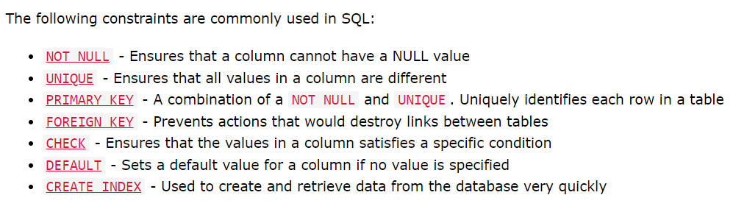
Common Constraints
In groups: write a short summary and give examples. Use the boards!
MySQL Constraints (w3schools.com)

Slide 10
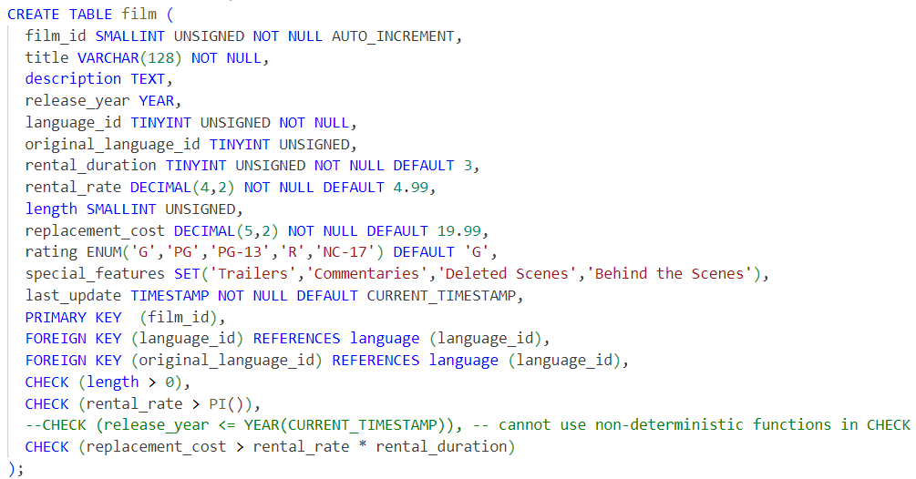
Some Examples
Notes:
NOT NULL
DEFAULT
PK
FK
CHECK
UNIQUE

Slide 11
An Exercise
Find and run the film_constraint.mysqlnotebook script. Inspect the DESCRIBE and SHOW CREATE TABLE outputs. What do you notice about the constraints?

Slide 12
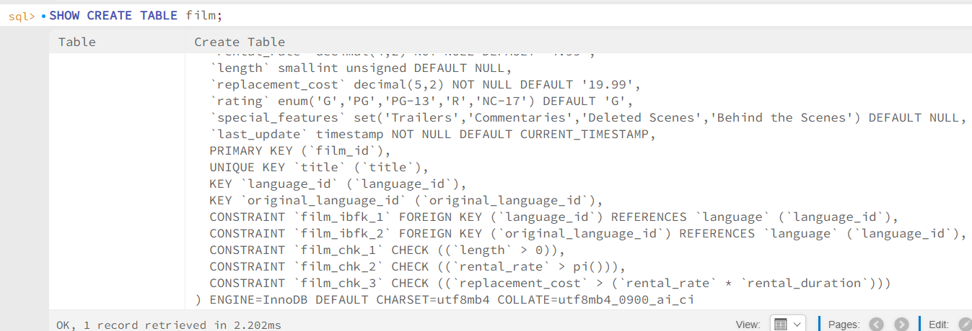
An Exercise

Slide 13
Constraint Syntax
CONSTRAINT identifier
[ PRIMARY KEY columnName
| FOREIGN KEY (columnName) REFERENCES TableName(columnName)
| CHECK (check conditions)
| KEY (columnName)
| UNIQUE KEY (columnName)
]

Slide 14
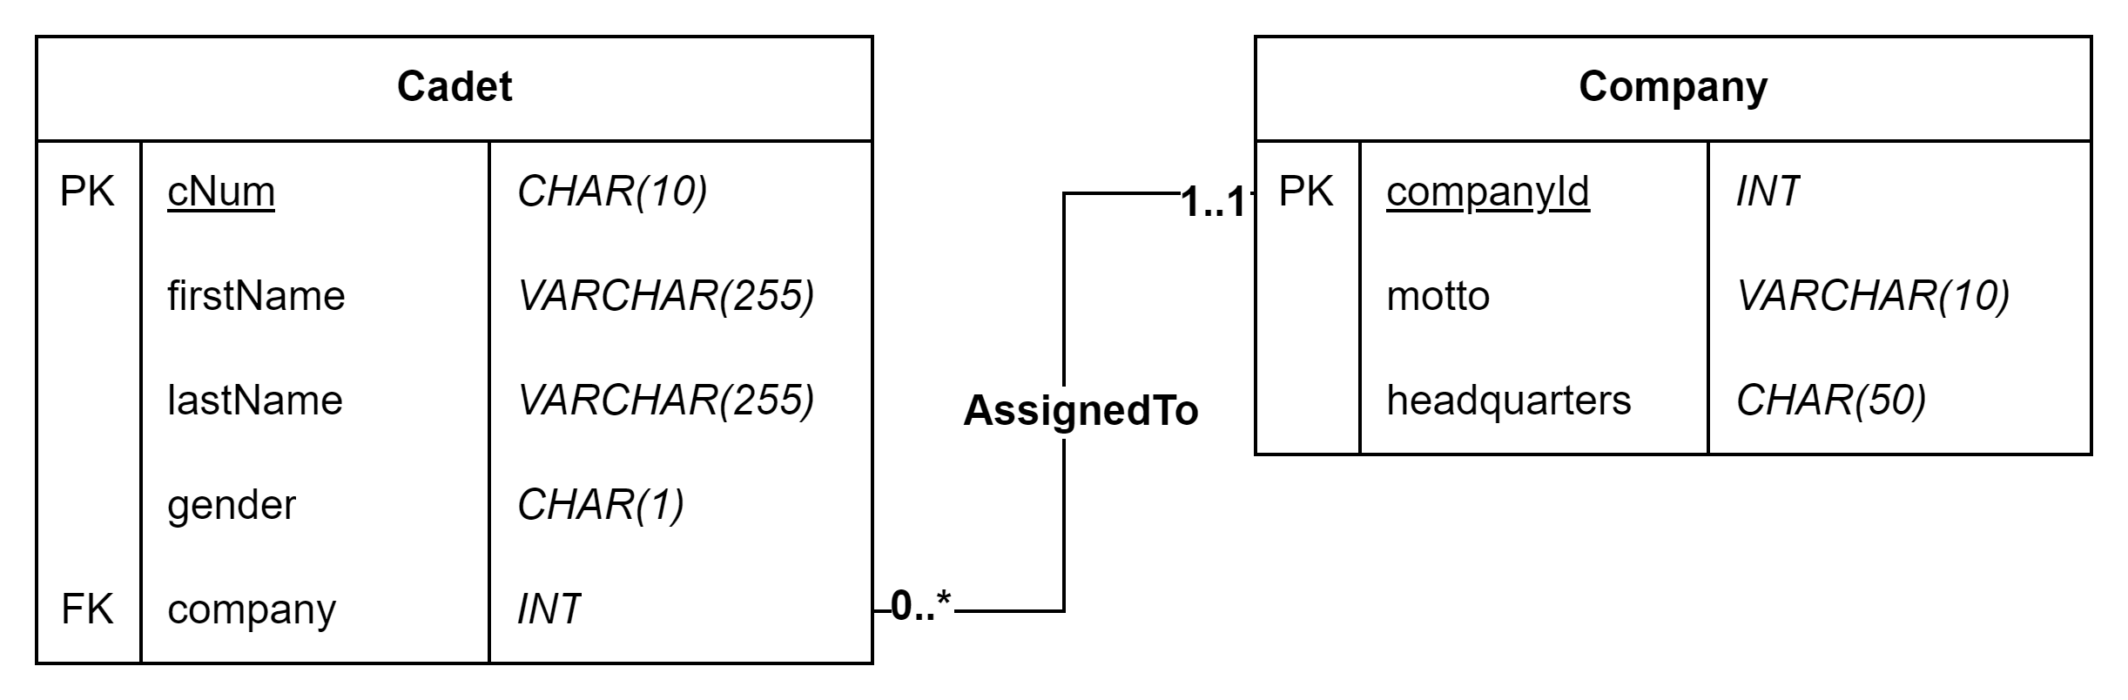
But my design diagrams…

Slide 15
Designing Constraints
Design diagrams generally don’t show constraints
They may be specified to you
Or you may need to infer them
If you’re the DBA, you should have many, many discussions with stakeholders about implementing constraints.

Slide 16
In Class Exercise
Download Elmwood University scenario and DB script.
Either recreate the tables with the appropriate constraints,
or utilize ALTER TABLE commands to do so.

Slide 17
Removing Constraints

Slide 18
Syntax
ALTER TABLE TableName
[ ADD CHECK (check conditions)
| ADD UNIQUE (columnName)
| ADD PRIMARY KEY (columnName)
| ADD FOREIGN KEY (columnName) REFERENCES TableName(columnName)
| ADD CONSTRAINT identifier ...
]

Slide 19
Syntax
ALTER TABLE TableName
[ DROP CHECK identifier
| DROP INDEX identifier
| DROP PRIMARY KEY
| DROP FOREIGN KEY identifier
| DROP CONSTRAINT identifier ...
]

Slide 20
Table Information
How can we get information about constraints again?
SHOW CREATE TABLE TableName;

Slide 21
In Class Exercise
Try dropping the Instructor table from Elmwood. What do you get?
Remove the CourseInstructor -> Instructor foreign key that we just added from the Elmwood scenario
Now try dropping the Instructor table.

Slide 22
An Aside
Businesses change, your database should change with them.
The database is often the last line of defense against “bad data”.

Slide 23
Last Exercise
Use the bookworld scenario
Create a design diagram
Implement the design diagram
Identify and add constraints where reasonable
Solutions available in Canvas - DON’T PEEK!

